Slide 1

FILM aPPRECIATION PARIYERUM PERUMAL
UVC20601L
RA2131002010014
DEVADARSHINI.L

Slide 2


INTRODUCTION
ABOUT:​
Title: "Parierum Perumal"​
Subtitle: "A Journey Through Caste and Friendship"​
Director: Mari Selvaraj​
Release Year: [2018]​
Pariyerum Perumal significantly impacted both the film industry and society. The film also ignited discussions about caste discrimination and social justice in India. It prompted essential conversations about the need to address deep-rooted inequalities and prejudices.​

Slide 3


Pariyerum Perumal (transl. The God who mounts a Horse) is a 2018 Indian Tamil-language drama film, directed by Mari Selvaraj in his directorial debut and produced by Pa. Ranjith under his production banner Neelam Productions. The film stars Kathir and Anandhi, while Yogi Babu and G. Marimuthu appear in supporting roles. The film features music composed by Santhosh Narayanan. with cinematography handled by Sridhar and editing done by Selva R. K. The film follows Pariyan (Kathir), who belongs to an oppressed caste and enters into law college with a lot of hope, and strikes up a friendship with Jothi Mahalakshmi (Anandhi), who belongs to an upper caste, which irks Jothi's family members. He wakes up to the realities of caste oppression and discrimination, after being harassed by them.​

Slide 4

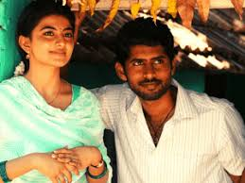
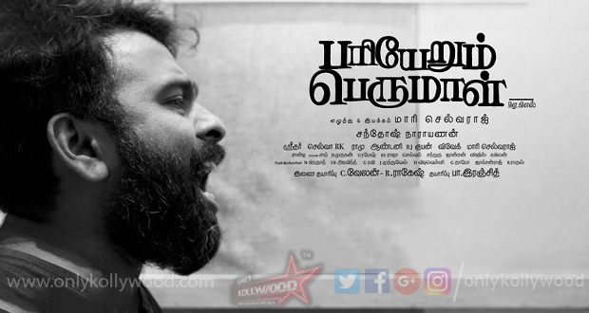

SYNOPSIS
Directed by | Mari Selvaraj
Written by | Mari Selvaraj
Produced by | Pa. Ranjith
Starring | Kathir Anandhi
Edited by | Selva R. K.
Music by | Santhosh Narayanan
Cinematography | Sridhar
Distributed by | Neelam Productions
Release date | Lyca Productions
Running time | 28 September 2018
Production company | 154 minutes
Language | India
Country | Tamil
• A summary of the plot, focusing on the protagonist's journey and the central themes of caste discrimination and friendship.
• The story begins with Pariyerum Perumal, a young man from a lower caste, who dreams of becoming a lawyer. He enrolls in a prestigious law college, where he encounters hostility and discrimination from students belonging to higher castes. Despite facing numerous challenges, Perumal is determined to succeed and overcome the obstacles in his path.As Pariyan navigates the complexities of college life, he forms a close friendship with jo( jyothi mahalakshmi fellow student from a higher caste. Their bond transcends societal barriers, and jo becomes a source of support and encouragement for Pariyan.However, their friendship faces opposition from jo's family and the conservative society they live in. The deep-rooted caste prejudices threaten to tear them apart, forcing Pariyan to confront the harsh realities of discrimination and injustice.Amidst the turmoil, Pariyan's resolve is tested, but he remains steadfast in his pursuit of education and justice. With the support of his friends and mentors, he confronts the oppressive caste system and strives to make a difference in society.The film culminates in a powerful climax that underscores the importance of solidarity and resilience in the face of adversity. Through Pariyan's journey, the film sheds light on the pervasive nature of caste discrimination and the need for social change.

Slide 5

World has more meanings,youth can make it more meaningful...

Slide 6
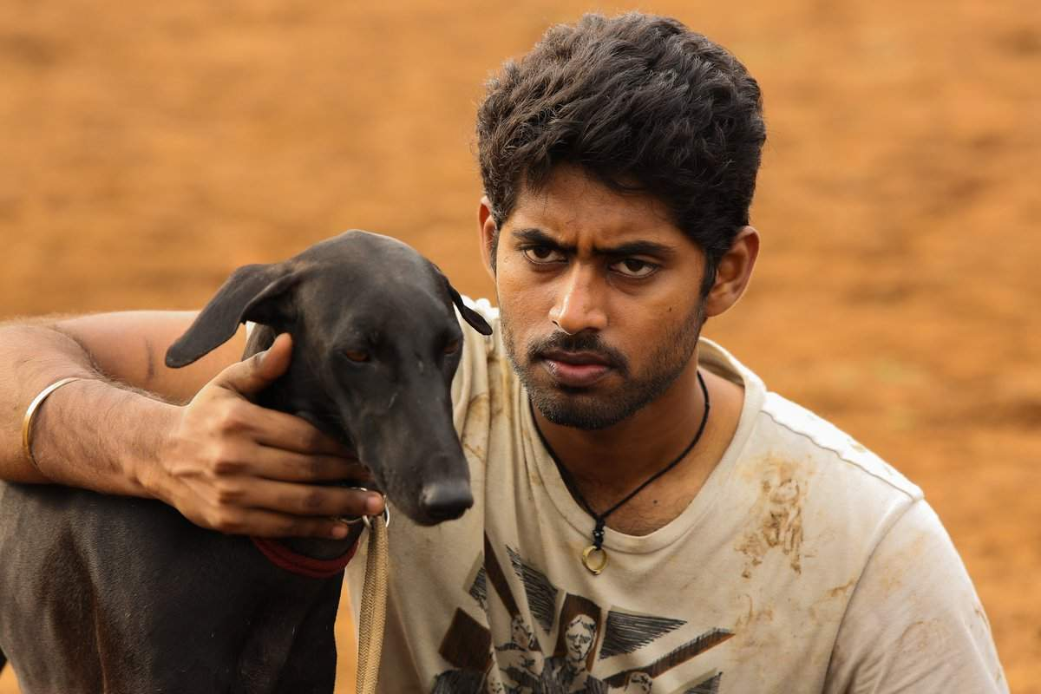
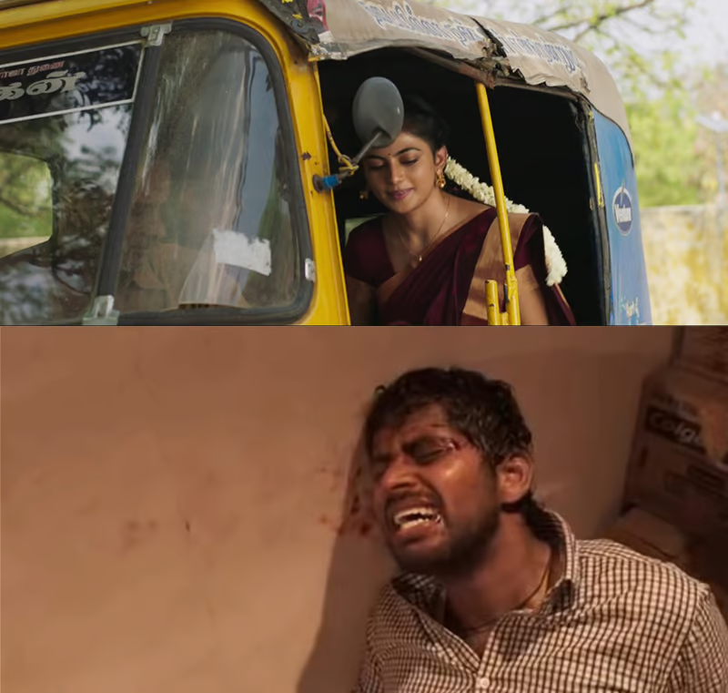
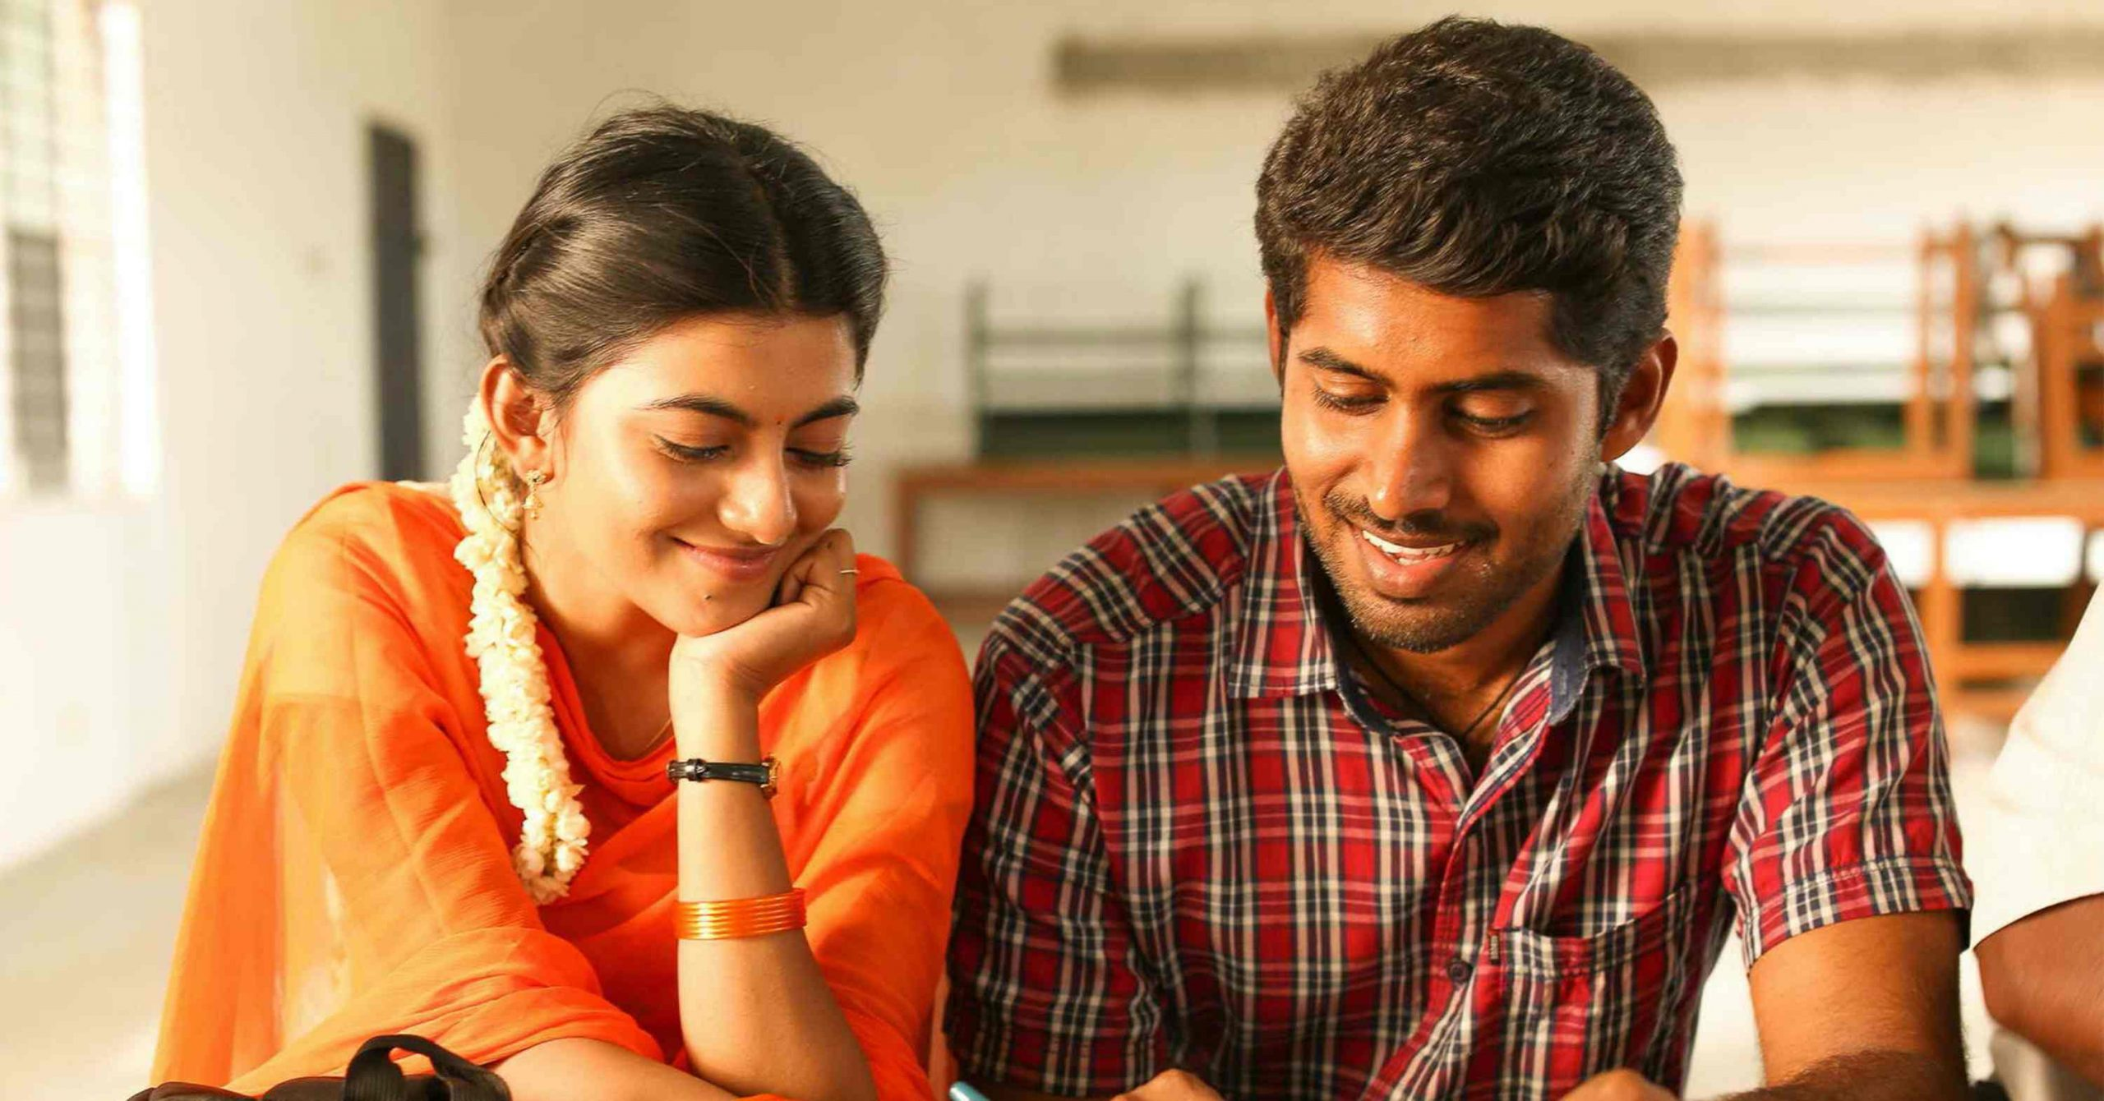
CHARACTERS AND THEMES:
Key characters:
• Parierum Perumal (Perumal)
• Jyothi Mahalakshmi
• anand
EXPLORATION OF MAJOR THEMES:
•Caste discrimination
•Pariyan is isolated from his upper-caste colleagues in college and experiences violence and humiliation due to the sharp caste-based division pervasive in society. It shows underprivileged groups' tenacity and struggle to claim their identity and dignity.
•Friendship and camaraderie
•Yogibabu (anand) and anandhi (jo) accepts parian has their friend . this denotes that friendship despite class and caste difference
•Education and empowerment
•The film also emphasises that Dalit activism and empowerment is possible through education.
Pariyerum Perumal vividly depicts the nexus between caste and gender inequality. Jo and Pariyan's characters show how those at the junction of two identities confront multiple forms of oppression. They face caste-based discrimination, gender-based violence, and societal norms that promote these inequities.

Slide 7
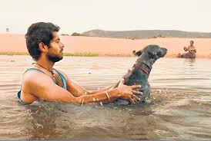
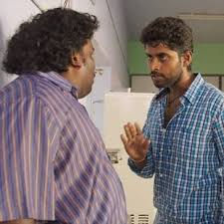
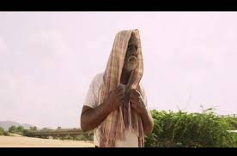

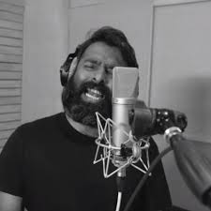
Setting
• Description of the rural Tamil Nadu setting and its significance to the story.
• The movie shoot in Tirunelveli and Thoothukudi dalit area to convey the originality of their lifestyle
Cinematography
• Analysis of visual elements:
• Use of colors, lighting, and camera angles
• Symbolism and visual storytelling techniques
Soundtrack
•Overview of the music and its role in enhancing the narrative.
• Santhosh Narayanan, was assigned to composed the music and background score of Pariyerum Perumal. Santhosh took the project as a mix of folk and conventional music,which is very much prevalent in the southern region of Tamil Nadu, where most of the native singers recorded the album.The songs reflect the theme of the film.

Slide 8
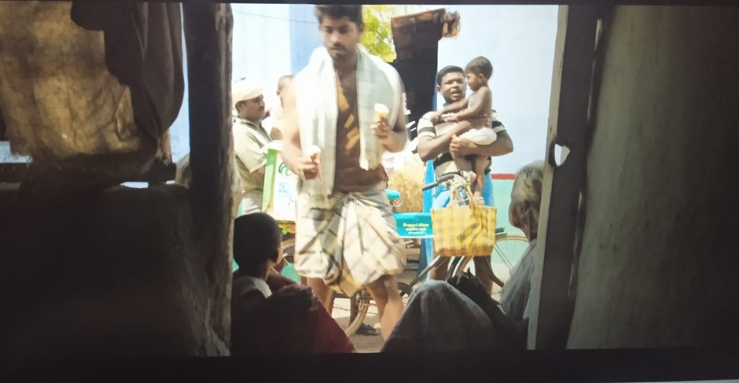
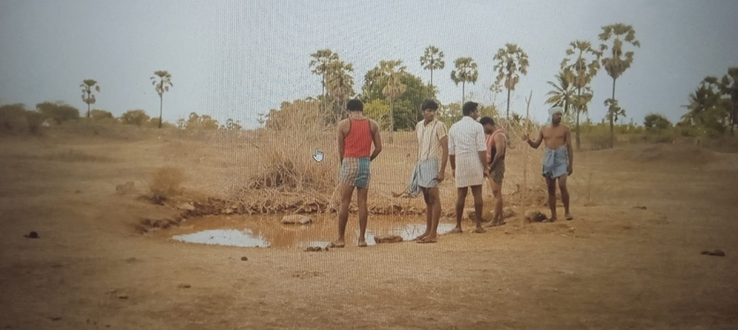
In the song "Vanakam Vanakam," the life of Pariyan is depicted in Puliyangulam. The poverty of the area is shown through scenes like Pariyan giving ice cream to two old ladies whose house lacks a door. Caste discrimination is highlighted when Pariyan cuts children's hair while his friends cut his. Despite these hardships, Pariyan is emotionally connected to the people of Puliyangulam, as shown by his daily work in the fields with his family and his interactions with the community
Another caste group arrives at the pond and starts urinating, showing disrespect. They express anger at the Pariyan group for hunting there and discuss intimidating them. Pariyan and others leave the pond, and one character questions why they should fear them. Another reminds them of potential legal consequences, noting the other group owns all their lands, leaving them with nothing

Slide 9
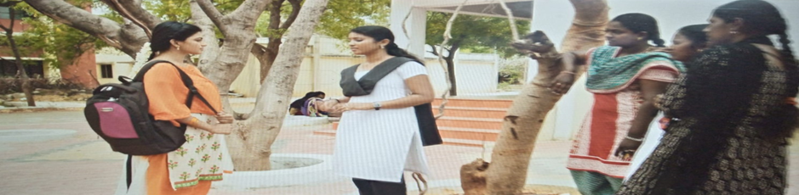
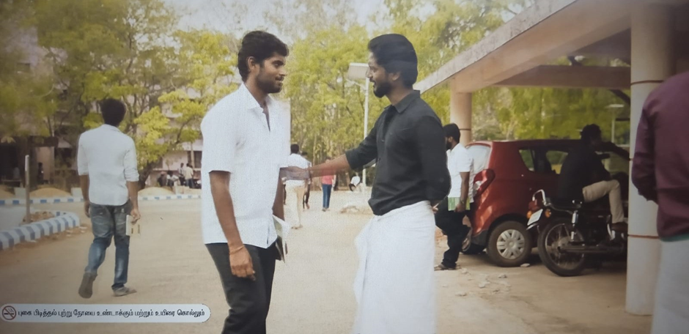
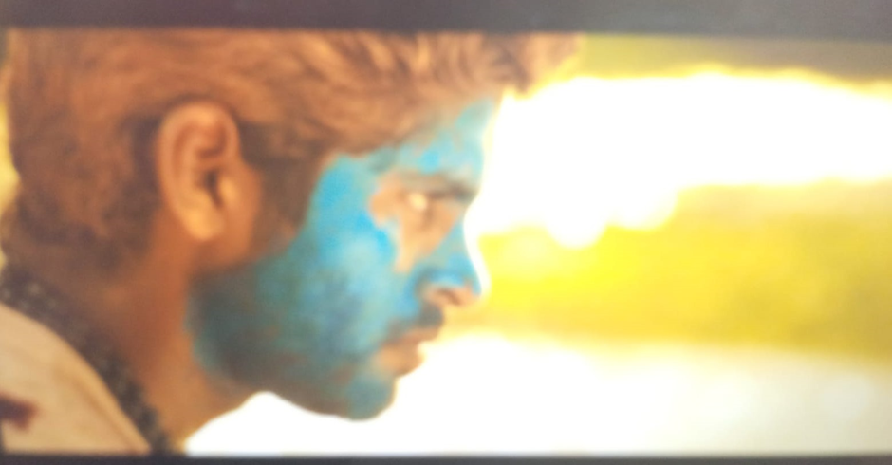
A. Pariyan's emotional connection with the karupi dog is shown, but it is later tied to a track by members of another caste to assert power.
B. Statues of Ambedkar, Mutthu Ramalinga Devar, Indra Gandhi, and MGR are shown, Ambedkar's statue shown at eye level and Mutthuramalinga Devar's from a low angle.
Pariyan is ragged by seniors who inquire about his hometown, revealing the practice of identifying caste based on origin. Jo, a senior girl, is ragged, and her caste is acknowledged by Sangaralingam, suggesting they are of the same caste.
The film uses Social, Linguistic, and Aesthetic Codes tailored to the audience's culture. Socio-cultural norms, such as dressing style and body language, are represented uniquely, with the color blue symbolizing the low caste.
The movie concludes by highlighting the reality of societal norms and people's suffering

Slide 10
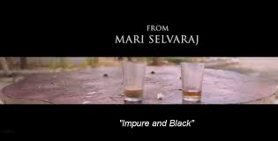
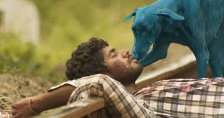

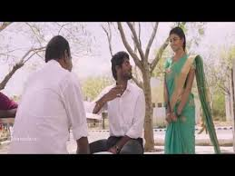
DIALOGUE:
that as long as he remains the same and expects Pariyan to remain a dog, nothing will change.
This dialogue shows that the differenciate will never end until the mindset and expectation of the high caste changes. This symbolzed in the end shot . The two glasses shows the distance and the marginilized life.
Critical Reception:
Praised for its hopeful tone against caste, with a touching climax. Won Best Film at 66th Filmfare Awards South.
Box Office Performance:
Opened with ₹15.36 lakh (US$19,000) in Chennai, rising to ₹55.23 lakh (US$69,000) in the second week. Lifetime collection of ₹5.5 crore (US$690,000), becoming a sleeper hit.

Slide 11

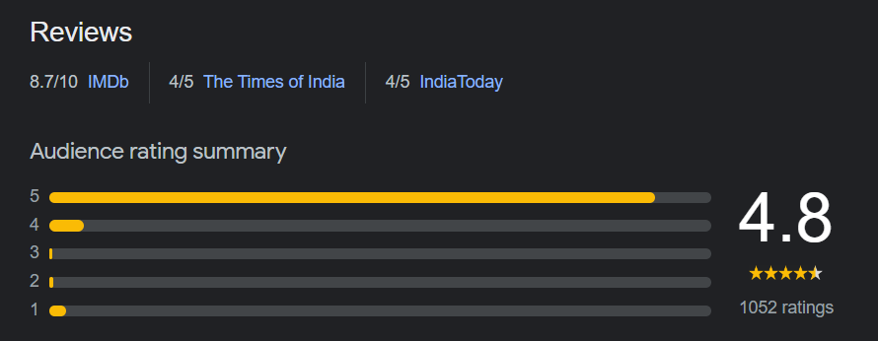

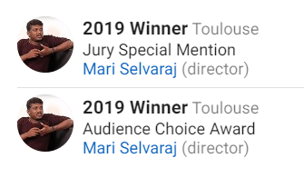


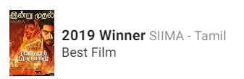


AWARDS AND RECOGNITION
References
•Citations for sources used in the presentation.
•Wikipedia

Slide 12
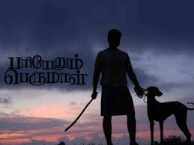
CONCLUSION
The movie fiercely refutes the idea of caste superiority and exposes the sneaky prejudices based on caste, even among those who appear progressive. It depicts the truth about how the lower caste people suffer from the higher castes in every aspect of their life.
It prompted essential conversations about the need to address deep-rooted inequalities and prejudices. Pariyerum Perumal is a powerful cinematic exploration of deeply ingrained caste discrimination, social injustice, and the resilience of the human spirit. Through its compelling narrative and masterful direction, the film draws attention to the harsh realities faced by marginalized communities in rural India. It highlights the enduring oppression and discrimination that persist despite progress in other areas. The film's characters, especially Pariyerum Perumal, symbolize resistance and hope, challenging the status quo and aspiring for a more just and equitable society. Pariyerum Perumal forces viewers to confront uncomfortable truths about caste-based discrimination while reminding us of the transformative potential of education, friendship, and solidarity.

Slide 13


THANK YOU

